Slide 1
Non-Anion Gap Metabolic Acidosis
App.GoSoapbox.com
665-971-584
then “Join Now”
Joel M. Topf, M.D.
http://PBFluids.com
@kidney_boy

Slide 2
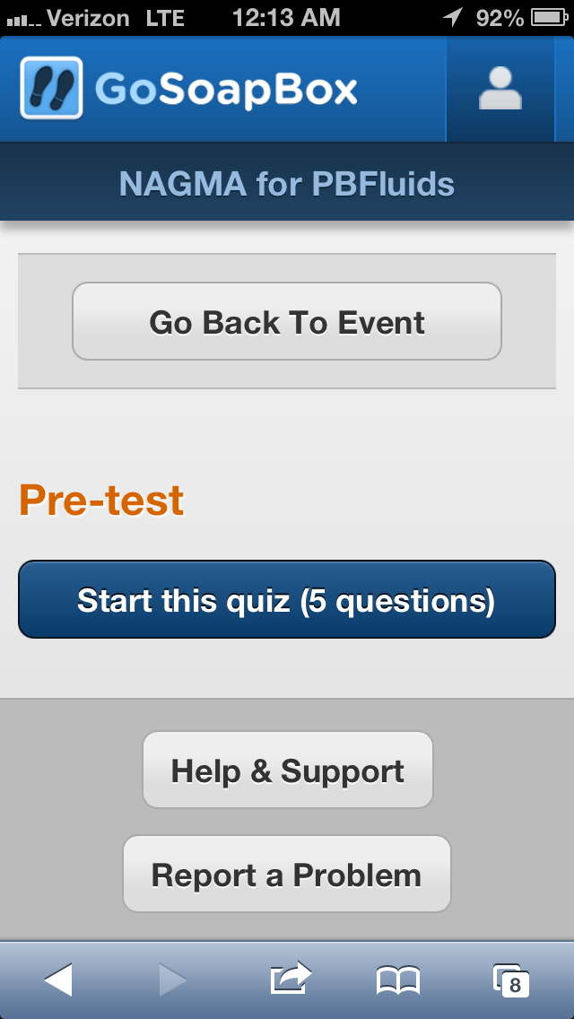
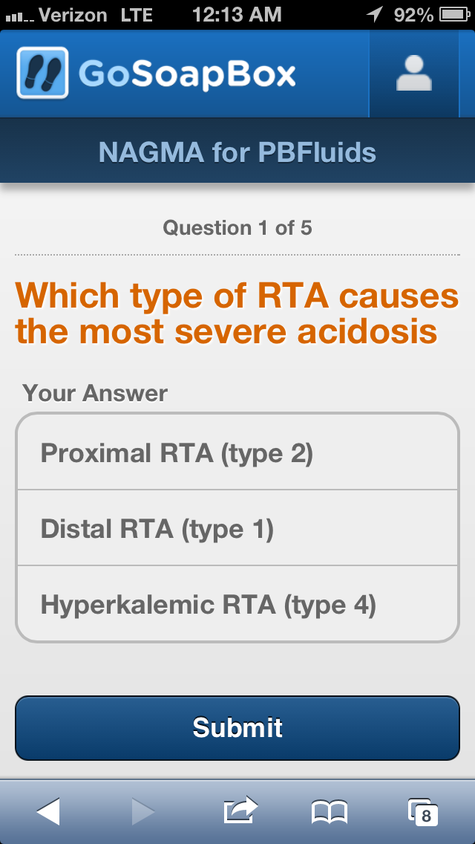
App.GoSoapbox.com 665-971-584

Slide 3
32 y.o. female with fatigue, weakness and muscle aches
App.GoSoapbox.com 665-971-584
Answer polls:
Uhura: What is the primary acid base…
Uhura: What is the appropriate pCO2…
16
1.0
139 115
3.1 17
7.34 / 33 / 87 / 18

Slide 4
32 y.o. female with fatigue, weakness and muscle aches
16
1.0
139 115
3.1 17
7.34 / 33 / 87 / 18

Slide 5
Determine the primary disorder
7.34 / 87 / 33 / 16
7.34 / 87 / 33 / 16
pH / pO2 / pCO₂ / HCO₃
Metabolic Acidosis
Acidosis or alkalosis
If the pH is less than 7.4 it is acidosis
If the pH is greater than 7.4 it is alkalosis
Acidosis or alkalosis
If the pH is less than 7.4 it is acidosis
If the pH is greater than 7.4 it is alkalosis
Determine if it is respiratory or metabolic
If the pH, bicarbonate and pCO₂ all move in the same direction (up or down) it is metabolic
If the pH, bicarbonate and pCO₂ move in discordant directions (up and down) it is respiratory
Determine if it is respiratory or metabolic
If the pH, bicarbonate and pCO₂ all move in the same direction (up or down) it is metabolic
If the pH, bicarbonate and pCO₂ move in discordant directions (up and down) it is respiratory

Slide 6
Predicting pCO₂ in metabolic acidosis: Winter’s Formula
In metabolic acidosis the expected pCO₂ can be estimated from the HCO₃
Expected pCO₂ = (1.5 x HCO₃) + 8 ± 2
If the pCO₂ is higher than predicted then there is an addition respiratory acidosis
If the pCO₂ is lower than predicted there is an additional respiratory alkalosis

Slide 7
Is the compensation appropriate?
Expected pCO₂ = (1.5 x HCO₃) + 8 ±2
7.33 / 87 / 33 / 17
pH / pO2 / pCO₂ / HCO₃
Appropriately compensated metabolic acidosis
• Expected pCO₂ = 31-35
• Actual pCO₂ is 33, which is within the predicted range, indicating appropriate respiratory compensation

Slide 8
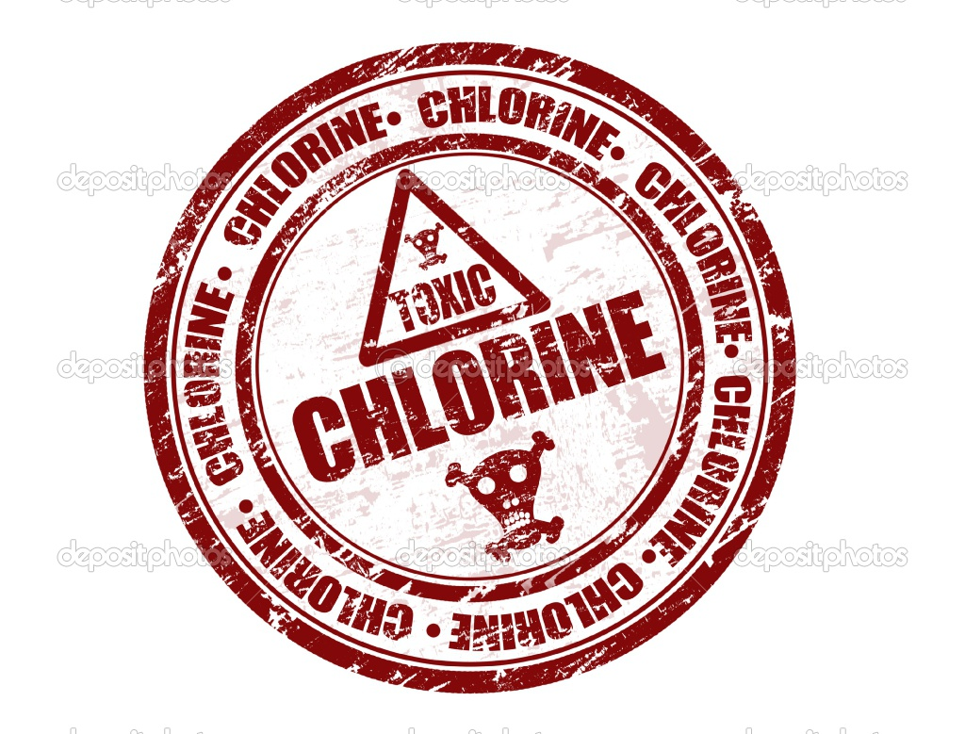
What anion is associated with the additional acid?

Slide 9
Metabolic acidosis is further evaluated by determining the anion associated with the increased H⁺ cation
In medicine we categorize the anions into:
chloride
not chloride
Non-Anion Gap
Metabolic Acidosis
Anion Gap
Metabolic Acidosis
…and differentiate the two based on the anion gap.

Slide 10
Anion gap
=

Slide 11
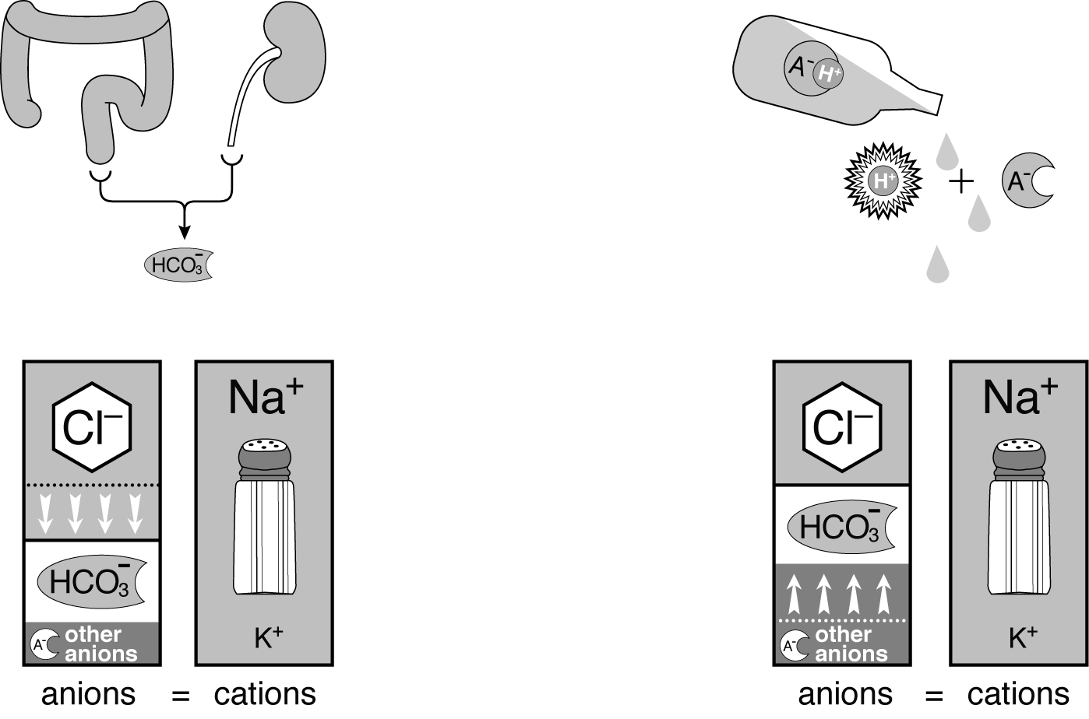
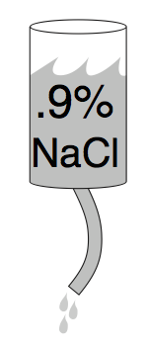
Anion gap
=
Goldmark
Mudpiles
Plumseeds

Slide 12
Calculating the anion gap
16
1.0
139 115
3.1 17
Anion gap = Na – (HCO₃ + Cl)
Normal is 12
Varies from lab to lab
Average anion gap in healthy controls is 6 ±3
Improving chloride assays have resulted in increased chloride levels and a decreased normal anion gap.

Slide 13
Calculating the anion gap
16
1.0
139 115
3.1 17
Appropriately compensated non-anion gap metabolic acidosis
Anion gap = Na – (HCO₃ + Cl)
Normal is 12
Varies from lab to lab
Average anion gap in healthy controls is 6 ±3
Improving chloride assays have resulted in increased chloride levels and a decreased normal anion gap.
Anion gap = 139 – (17 + 115)
Anion gap = 7
Varies from lab to lab
Average anion gap in healthy controls is 6 ±3
Improving chloride assays have resulted in increased chloride levels and a decreased normal anion gap.

Slide 14
Non-anion gap metabolic acidosis

Slide 15
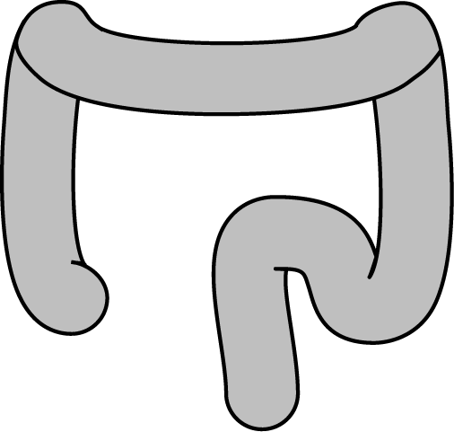
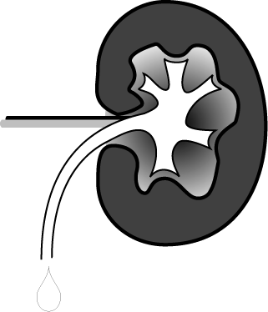
NAGMA
Chloride intoxication Dilutional acidosis
HCl intoxication
Chloride gas intoxication
Early renal failure
GI loss of HCO₃
Diarrhea
Surgical drains
Fistulas
Ureterosigmoidostomy
Obstructed ureteroileostomy
Cholestyramine
Renal loss of HCO₃
Renal tubular acidosis
Proximal
Distal
Hypoaldosteronism

Slide 16
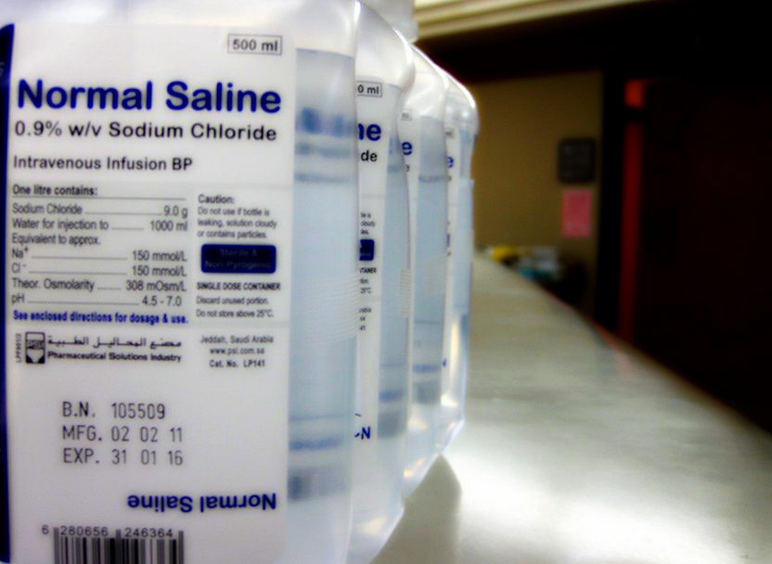
pH = 5.5
Cl = 154 mmol/L
Plasma volume 3 liters
Plasma Cl = 105

Slide 17
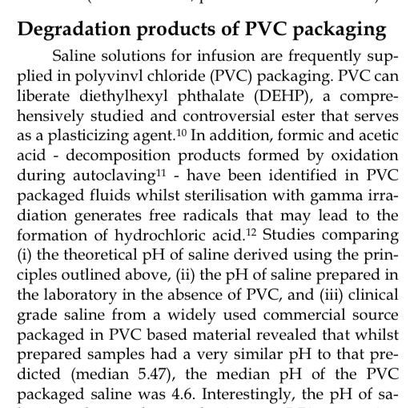
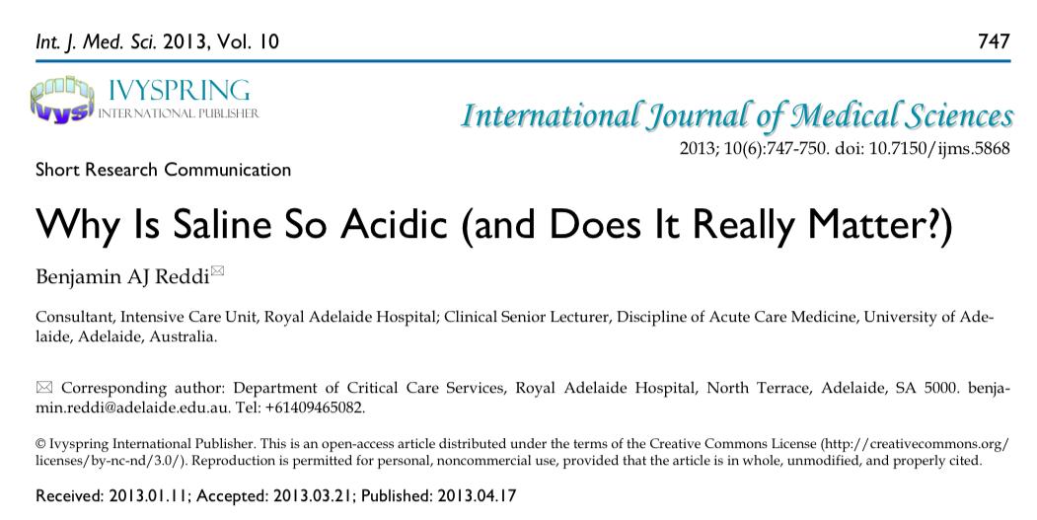

Slide 18
Increases in exogenous acid drive the reaction to the right, bicarbonate is consumed
Decreases in bicarbonate force the reaction to the left, replacing the bicarbonate and increasing H⁺

Slide 19
in both, the end result is an increase in H⁺ and a decrease in HCO₃,
the defining characteristic of metabolic acidosis

Slide 20
In NAGMA we will use the “loss of HCO₃” model

Slide 21
NAGMA
Chloride intoxication Dilutional acidosis
HCl intoxication
Chloride gas intoxication
Early renal failure
GI loss of HCO₃
Diarrhea
Surgical drains
Fistulas
Ureterosigmoidostomy
Obstructed ureteroileostomy
Cholestyramine
Renal loss of HCO₃
Renal tubular acidosis
Proximal
Distal
Hypoaldosteronism

Slide 23
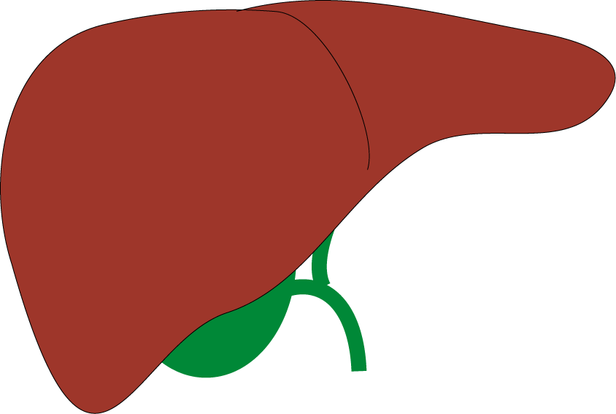
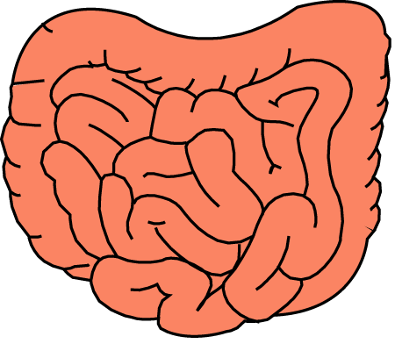
Plasma
140 102
4.4 24
135 100
5.0 35
Bile
135 50
5.0 90
Pancreas
135 50
5.0 90
Small intestines
110 90
35 40
Large intestines

Slide 24
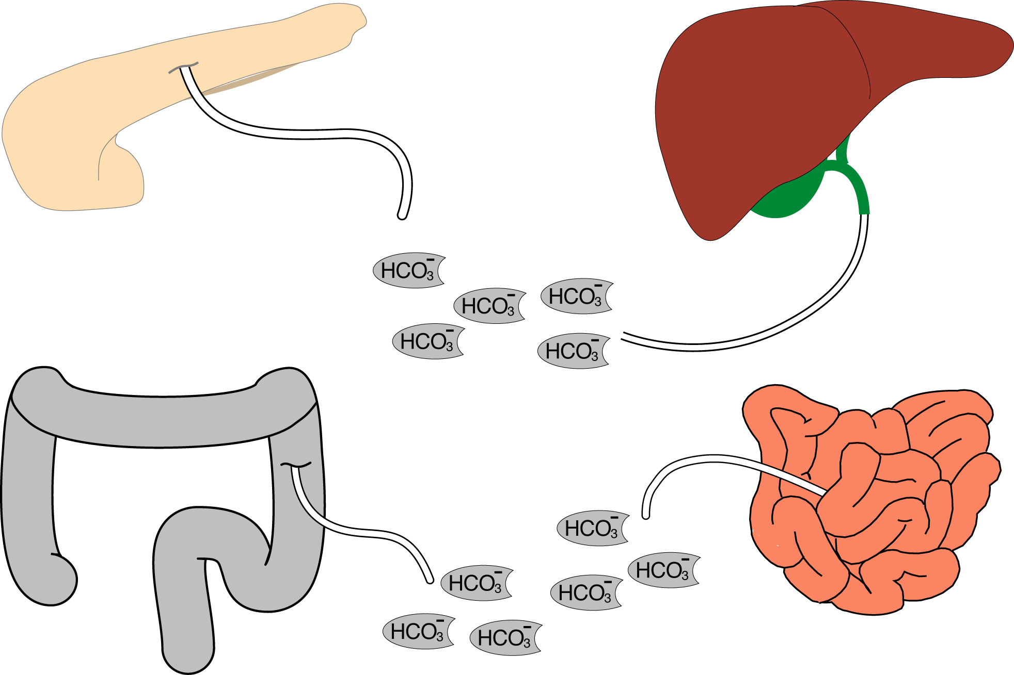

Slide 25
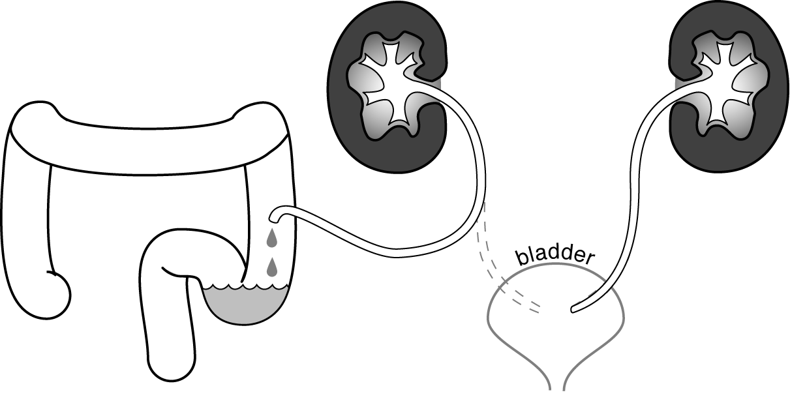
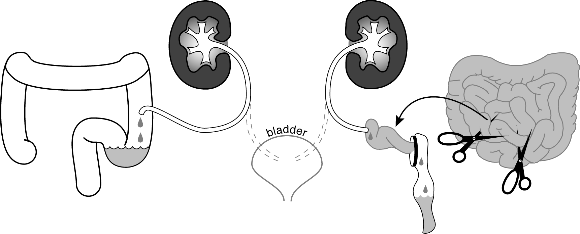
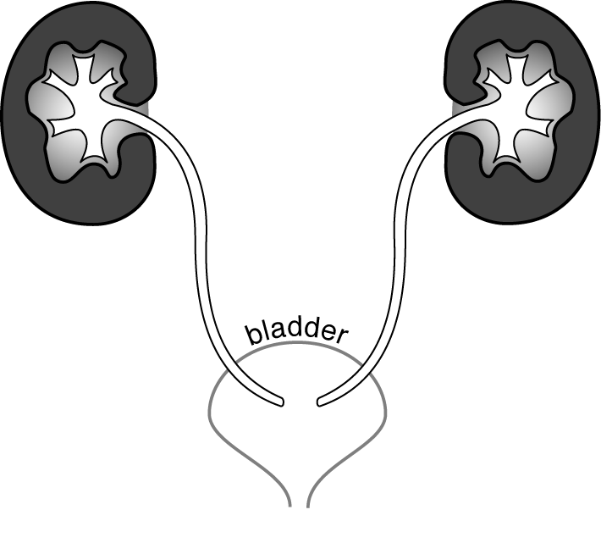
Urine pH=5.5
Serum pH=7.4
100 fold difference
Ureterosigmoidostomy
Ureteroileostomy

Slide 26
Urinary diversion
Urine NH₄⁺ is absorbed by the intestinal mucosa and converted to H⁺ and NH₃.
Urine Chloride stimulates colonic expression and activation of Cl⁻/HCO₃⁻ exchangers exacerbating the loss of bicarbonate.
Increased colonic pressures can cause urinary obstruction resulting in a urinary acidification defect
Repeated episodes of pyelonephritis may do the same

Slide 27
NAGMA
Chloride intoxication Dilutional acidosis
HCl intoxication
Chloride gas intoxication
Early renal failure
GI loss of HCO₃
Diarrhea
Surgical drains
Fistulas
Ureterosigmoidostomy
Obstructed ureteroileostomy
Cholestyramine
Renal loss of HCO₃
Renal tubular acidosis
Proximal
Distal
Hypoaldosteronism

Slide 28
Renal causes of NAGMA: Renal Tubular Acidosis (RTA)
RTA can be due to a failure of the kidney to
Reabsorb all of the filtered bicarbonate
Synthesize new bicarbonate to replace bicarbonate lost to metabolism
Stow hydrogen ions in ammonia so we can clear the daily acid load

Slide 29
The kidney’s role in HCO₃ hand-ling is not excretory, rather the kidney needs to reabsorb the thousands of millimoles of filter-ed bicarbonate and synthesize a few dozen millimoles of bicarb-onate to replace the bicarbonate lost to the daily acid load.

Slide 30
The kidney’s role in HCO₃ hand-ling is not excretory, rather the kidney needs to reabsorb the thousands of millimoles of filter-ed bicarbonate and synthesize a few dozen millimoles of bicarb-onate to replace the bicarbonate lost to the daily acid load.

Slide 31
The kidney’s role in HCO₃ hand-ling is not excretory, rather the kidney needs to reabsorb the thousands of millimoles of filter-ed bicarbonate and synthesize a few dozen millimoles of bicarb-onate to replace the bicarbonate lost to the daily acid load.

Slide 32
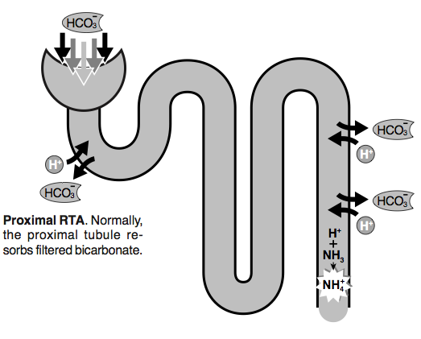
Reabsorption How much bicarbonate is filtered everyday?
Normal plasma HCO₃ concentration is 24 mmol/L
Normal GFR is 100 mL/min, or 0.1 L per minute
1440 minutes in a day
24 × 0.1 × 1440 =
3,456 mmol of bicarbonate are filtered a day (filtered load)

Slide 33
Synthesis How much bicarbonate needs to be replaced? How much bicarbonate is consumed? The daily acid load
Protein metabolism consumes bicarbonate
1 mmol/kg
2 mmol/kg in children
4 mmol/kg in infants
This bicarbonate must be replaced to maintain homeostasis

Slide 34
Two jobs, two locations
The proximal tubule needs to reabsorb 3,456 mmol of bicarbonate that is filtered every day.
Proximal tubule
The kidney must synthesize 50-100 mmol per day of new HCO₃ to replace HCO₃ lost buffering the daily acid load.
Cortical collecting tubule
3456 mmol/day
50-100 mmol/day

Slide 35
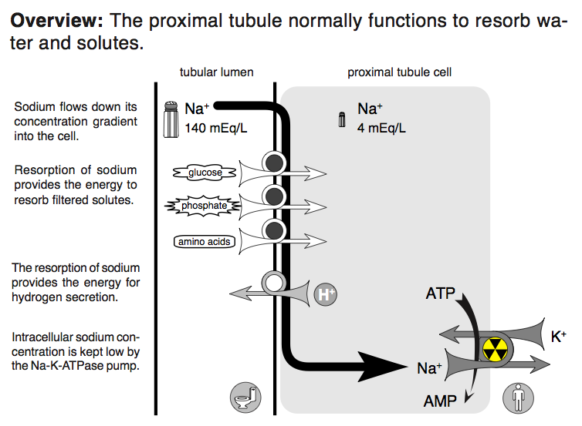

Slide 36
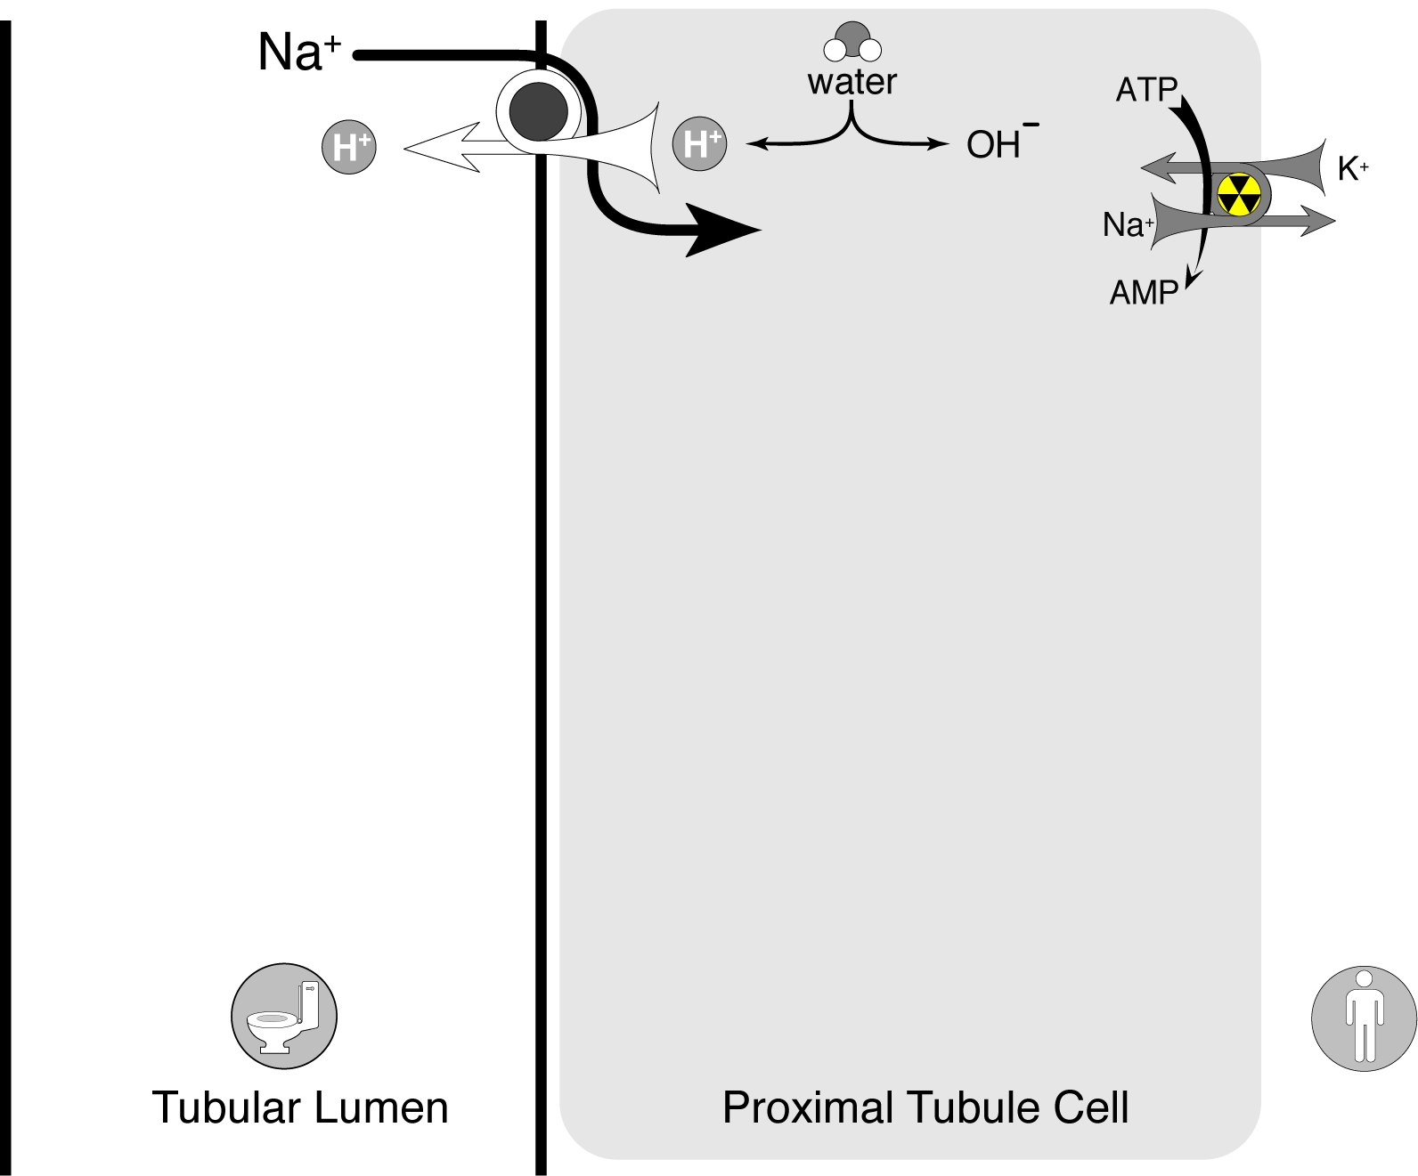
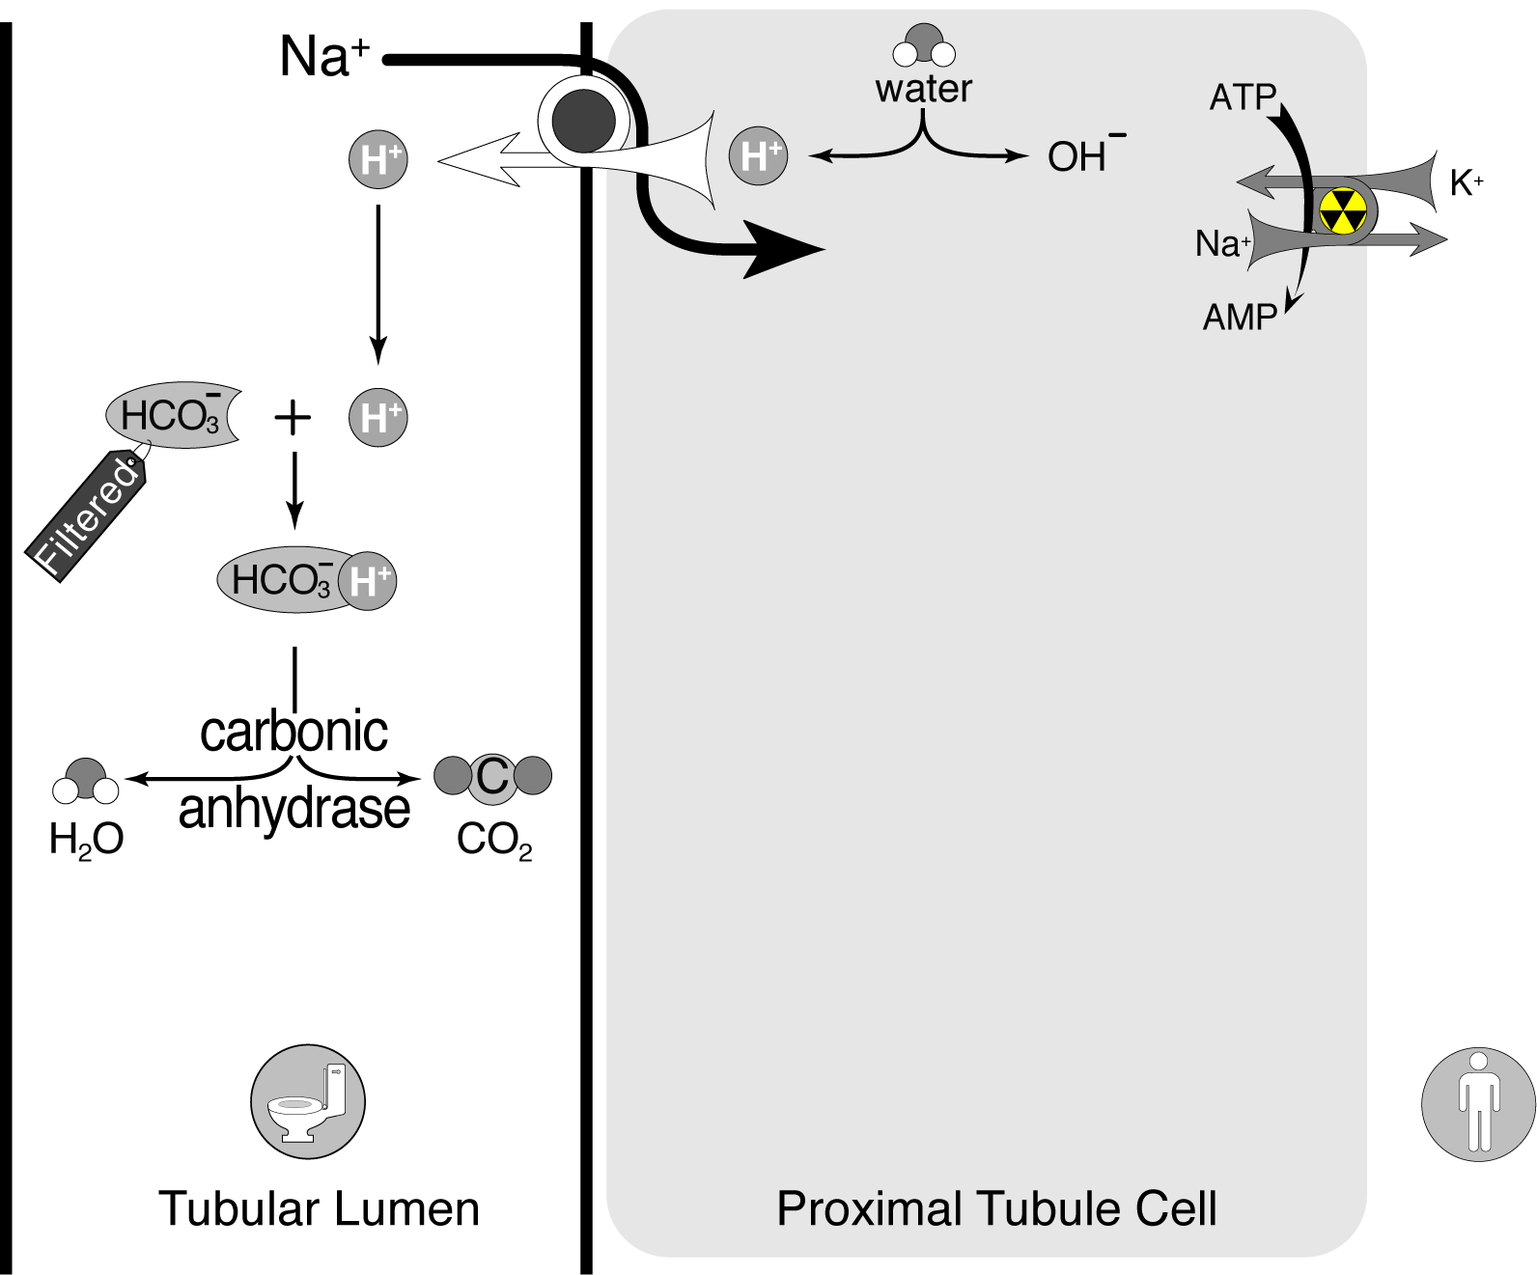
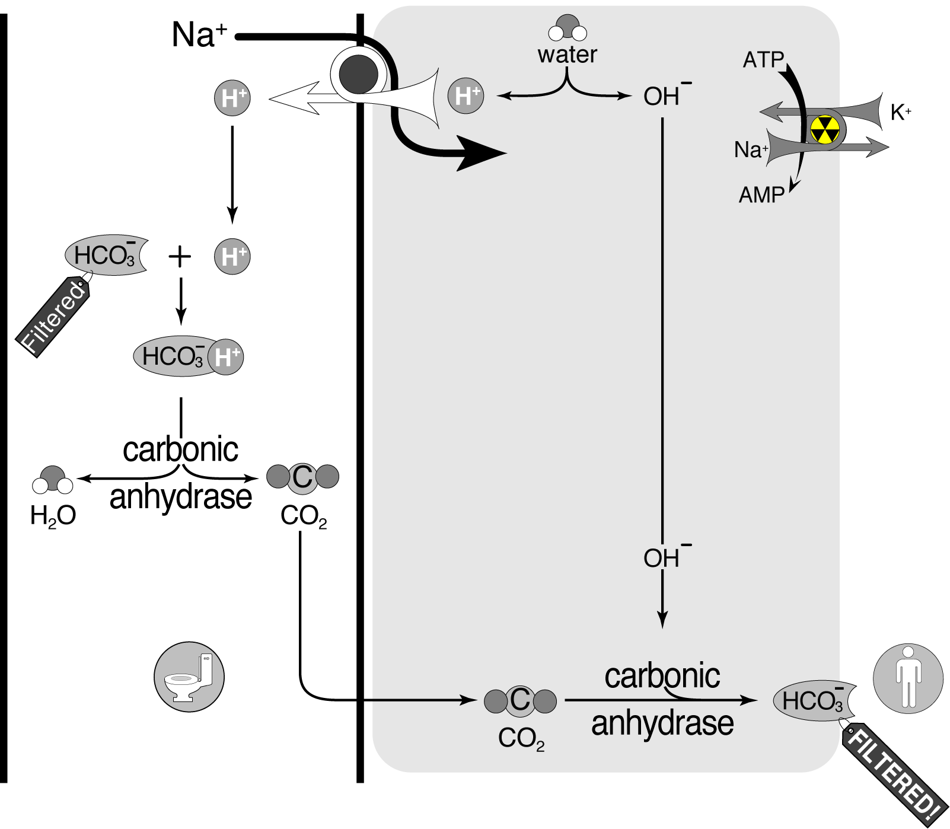
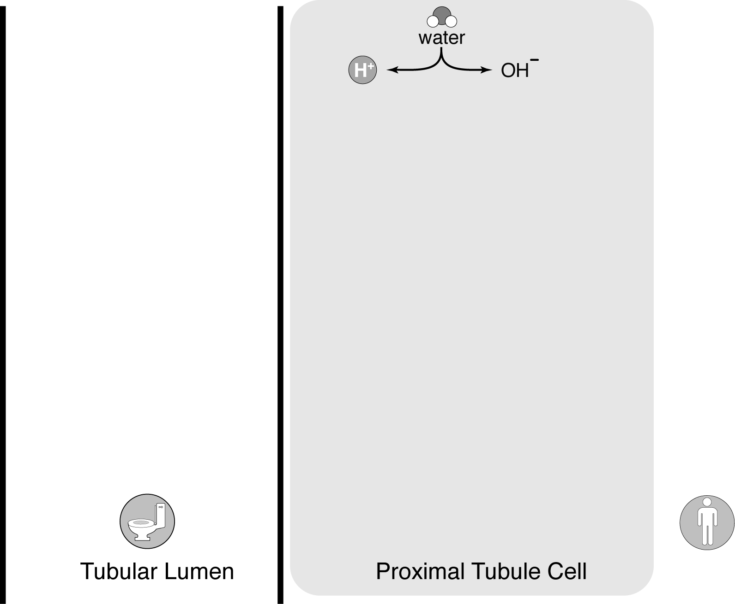
Proximal tubule: reabsorption of filtered bicarbonate

Slide 37
Bicarbonate handling
The proximal tubule needs to reabsorb 3,456 mmol of bicarbonate that is filtered every day.
Proximal tubule
The kidney must synthesize 50-100 mmol per day of new HCO₃ to replace HCO₃ lost buffering the daily acid load.
Cortical collecting tubule
3456 mmol/day
50-100 mmol/day

Slide 38
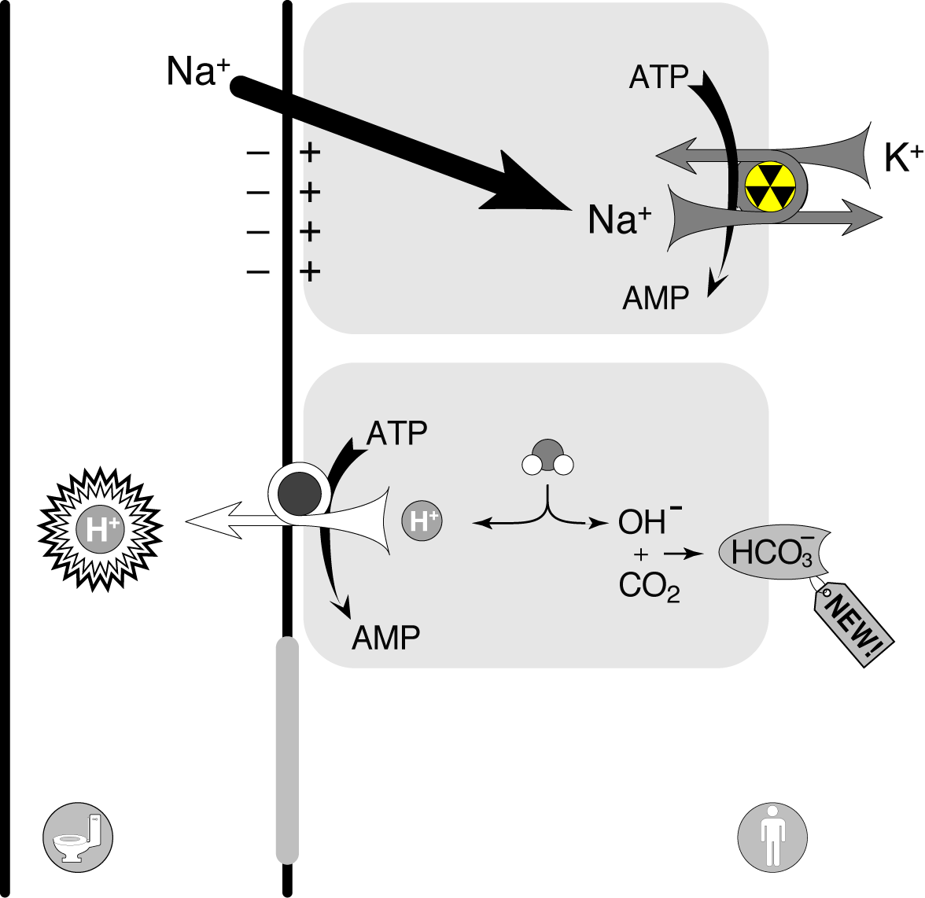
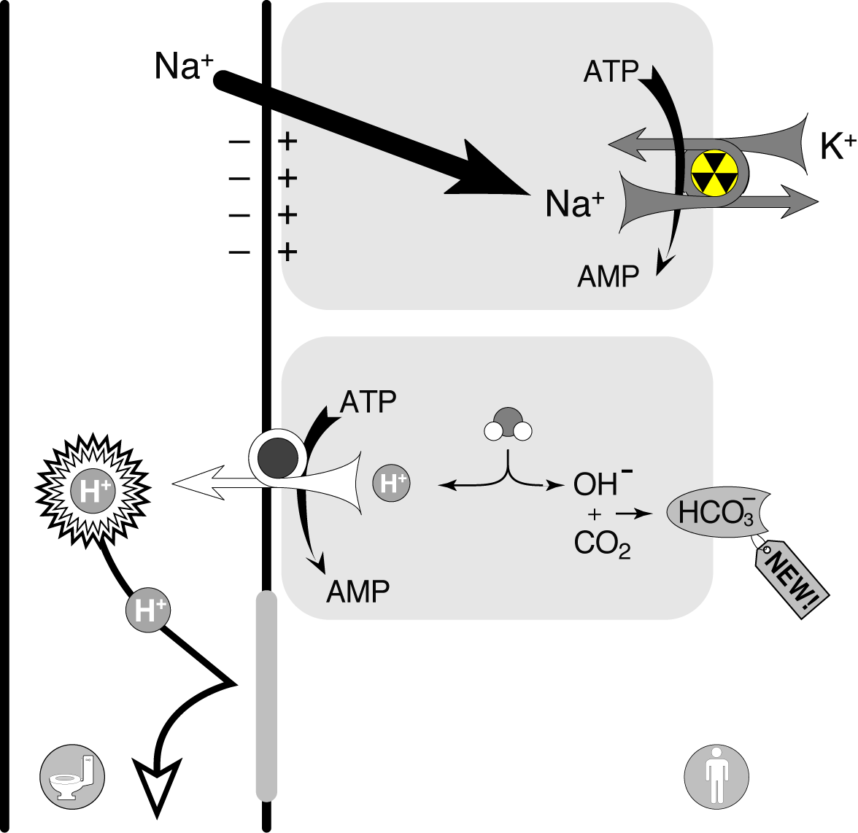
Distal tubule, completion of reabsorption and replacing bicarbonate lost to the daily acid load.
3 step process:
Electrogenic movement
of sodium into the
tubular cells (eNaC)
H⁺ pumped into the
tubular lumen ATPase
Maintain the 1000 fold
concentration gradient

Slide 39
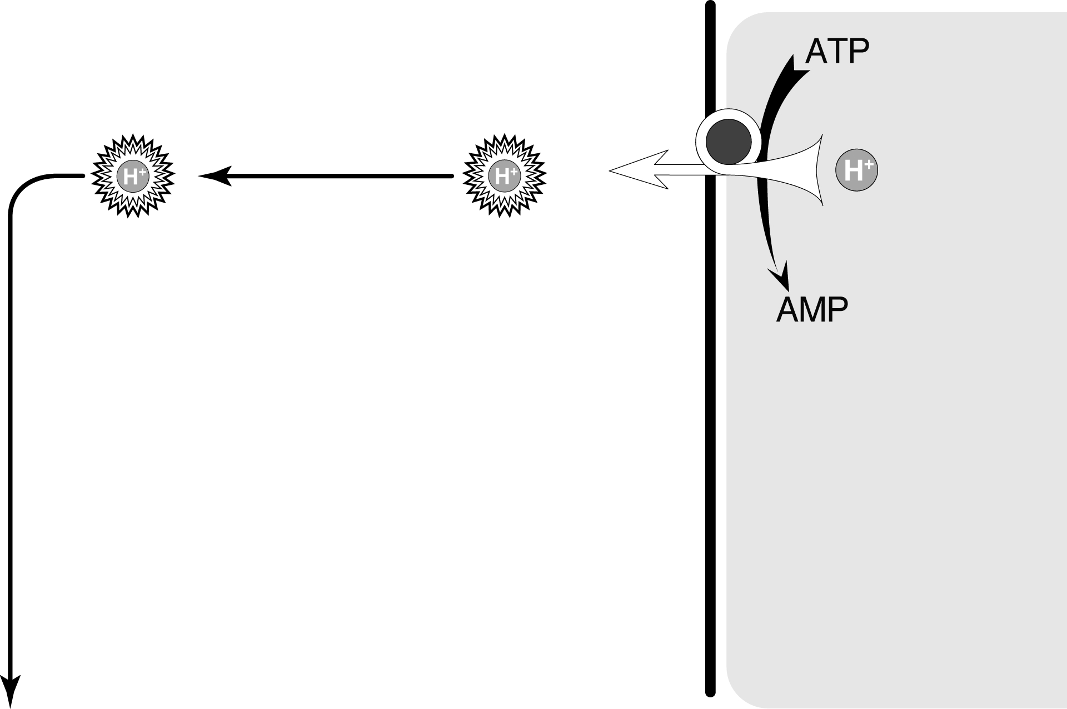
Fate of excreted hydrogen ion
The minimal urine pH is 4.5. This is a H⁺ concentration a 1000 times that of plasma.
But
It still is only 0.04 mmol/L
In order to excrete 50 mmol (to produce enough bicarb-onate to account for the daily acid load) one would need…
1,250 liters of urine.

Slide 40
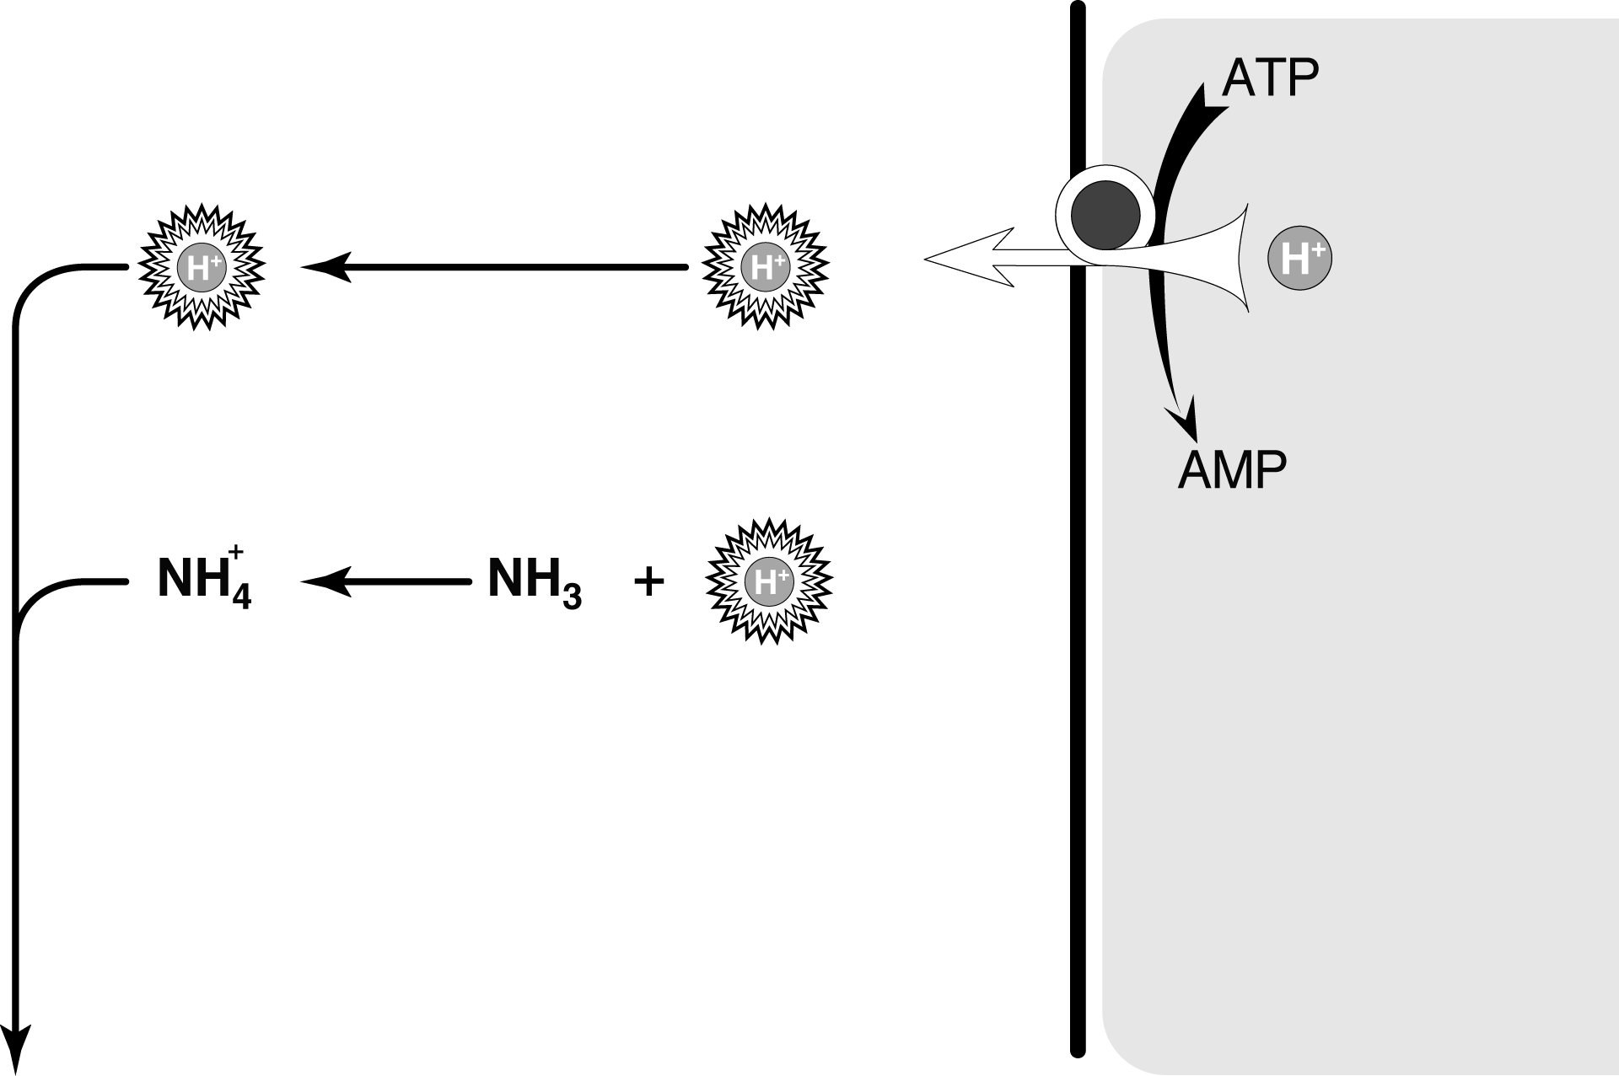
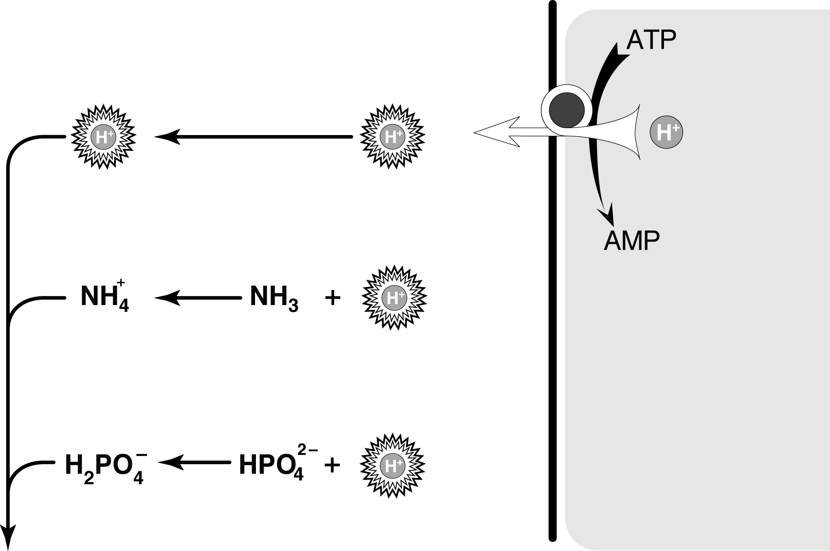
Fate of excreted hydrogen ion
Ammonium
Titratable acid

Slide 41
Excretion of the daily acid load as free hydrogen is limited by a minimum urinary pH of 4.5
Only 0.1% of the daily acid load is excreted this way
Titratable acid is urinary phosphate
Titratable acid carries a significant portion of the daily acid load
Limited by dietary phosphate
Does not respond to changes in the acid load
Ammonium carries the bulk of the daily acid load
In response to an acid load the kidney will increase production of ammonia (NH₃) in order to accept additional protons to carry the load

Slide 42
3 steps in renal bicarbonate handling
3456 mmol/day
50-100 mmol/day

Slide 43
Each step can fail which causes RTA and NAGMA
2
1
3456 mmol/day
Proximal RTA
50-100 mmol/day
4
Distal RTA
Hyperkalemic RTA

Slide 44
Proximal RTA (Type 2)
The Tm is the maximum plasma concentration of any solute at which the proximal tubule is able to completely reabsorb the solute.
Beyond the Tm the substance will be incompletely reabsorbed and spill in the urine.
In Proximal RTA the Tm for bicarbonate is reduced from 26 to 15-20 mmol/L.
Na⁺
H₂O
Amino Acids
HCO₃
Glucose

Slide 45
Proximal RTA (Type 2)
Damage to the proximal tubule decreases its Tm from 28 to somewhere in the mid-teens
Tm for HCO₃ at 15
Serum HCO₃ is > Tm so HCO₃ spills into the urine
24 mmol/L
15 mmol/L
pH 8

Slide 46
Proximal RTA (Type 2)
Serum HCO₃ then falls
When it falls to the Tm (15 mmol/L) the kidney appears to work normally
Homeostasis resumes but at a decreased HCO₃
15 mmol/L
15 mmol/L
pH 5

Slide 47
Proximal RTA (Type 2)
If the patient encounters an acid load, they synthesize new bicarbonate to return the serum HCO₃ to altered Tm (15)
12 mmol/L
12 mmol/L
pH 5

Slide 48
Proximal RTA (Type 2)
During treatment with exogenous bicarbonate the serum bicarbonate will rise above the Tm and the patient will spill bicarbonate
20 mmol/L
15 mmol/L
pH 8

Slide 49
Proximal RTA: etiologies
Acquired
Acetylzolamide
Ifosfamide
Chronic hypocalcemia
Multiple myeloma
Cisplatin
Lead toxicity
Mercury poisoning
Streptozocin
Expired tetracycline
Genetic
Cystinosis
Galactosemia
Hereditary fructose intolerance
Wilson’s disease
Hyperparathyroidism
Variable
Chronic respiratory alkalosis
Intracellular alkalosis

Slide 50
Respiratory alkalosis
7.44 / 87 / 22 / 15
pH / pO2 / pCO₂ / HCO₃
The pCO₂ falls due to the primary pathology
The bicarbonate falls to compensate
The Tm for bicarbonate is lowered

Slide 51
Proximal RTA: consequences
Loss of potassium (hypokalemia)
Bone disease
Bone buffering of the acidosis
Decreased growth
Not typically complicated by stones

Slide 52
Each step can fail which causes RTA and NAGMA
2
1
3456 mmol/day
Proximal RTA
50-100 mmol/day
4
Distal RTA
Hyperkalemic RTA

Slide 53
Distal RTA,
the Murphy’s Law of HCO₃ handling

Slide 54
Distal RTA, the Murphy’s Law of distal HCO₃ handling

Slide 55
Distal RTA (Type 1)
Failure can happen at any one of the three steps in urinary acidification

Slide 56
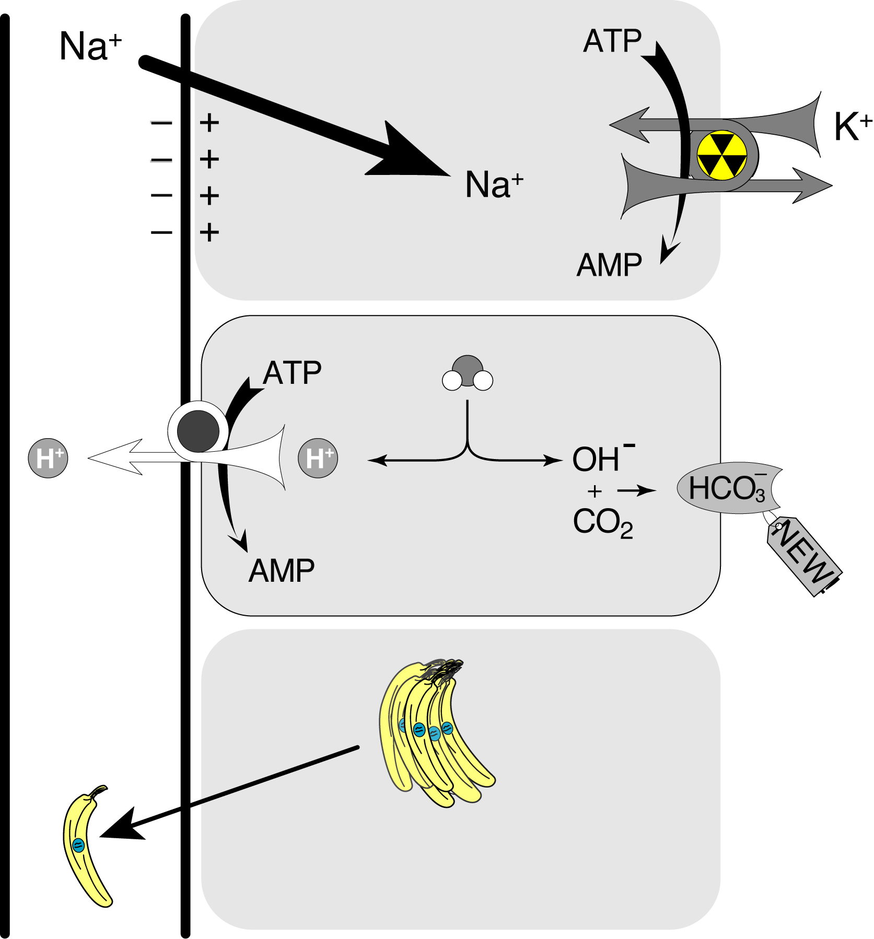
Distal RTA: Voltage dependent
Only variety of distal RTA which is hyperkalemic
Differentiate from type 4 by failure to respond to fludrocortisone.
Obstructive uropathy
Sickle cell anemia
Lupus
Triameterene
Amiloride

Slide 57
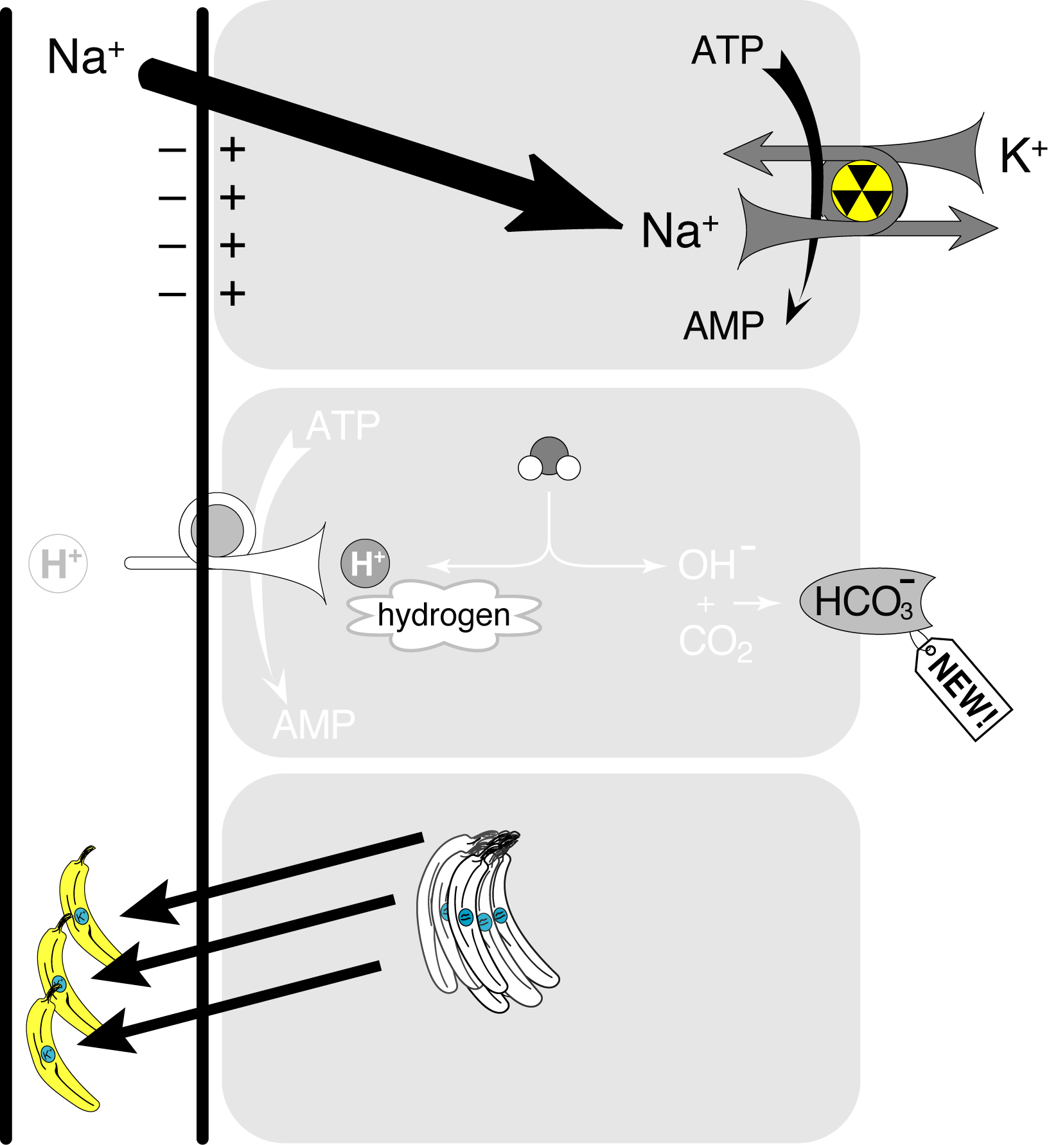
Distal RTA: H⁺ Secretion
Called classic distal RTA
Most common cause of distal RTA
Congenital
Lithium
Multiple myeloma
Lupus
Pyelonephritis
Sickle cell anemia
Sjögren’s syndrome
Toluene (Glue sniffing)
Wilson’s disease

Slide 58
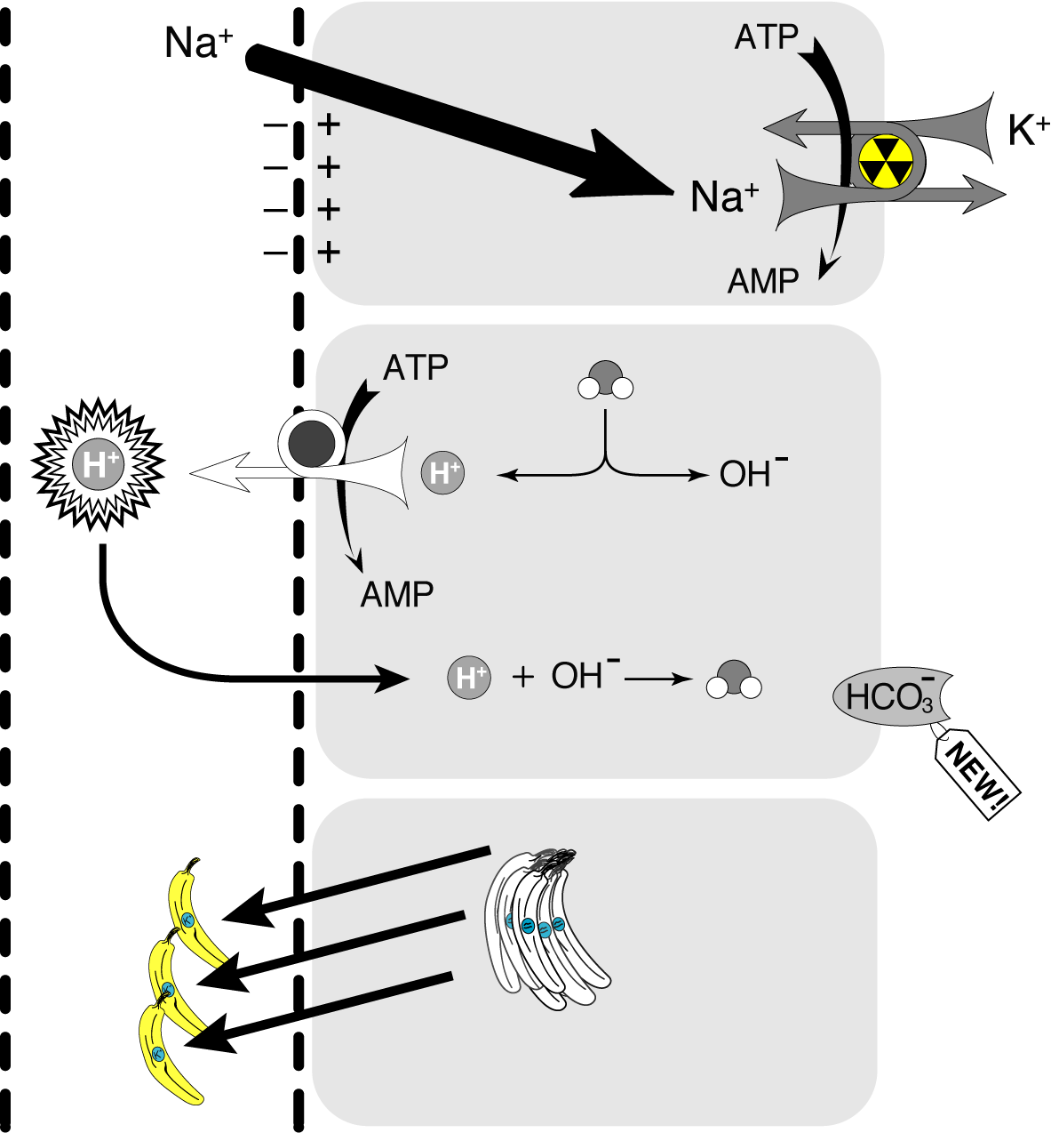
Distal RTA: Gradient defect
Amphotercin B

Slide 59
Distal RTA: consequences
Bones
Chronic metabolic acidosis results in bone buffering.
Bicarbonate
Phosphate
Calcium
Kidney stones
Calcium phosphate stones
Due to hypercalciuria
Increased urine pH
Decreased urinary citrate
Well Mr. Osborne, it may not be kidney stones after all.

Slide 60
Each step can fail which causes RTA and NAGMA
2
1
3456 mmol/day
Proximal RTA
50-100 mmol/day
4
Distal RTA
Hyperkalemic RTA

Slide 61
Chronic hyperkalemia of any etiology decreases ammoniagenesis
NH₃ is needed to excrete excess H⁺ in the urine

Slide 62
Intracellular acidosis stimulates intra-renal ammonia production
Intracellular alkalosis suppresses intra-renal ammonia production
With increases in serum potassium, potassium shifts inside the cells
Intracellular
alkalosis
To maintain electroneutrality, H⁺ moves out of the cells

Slide 63
Hypoaldosteronism: Type 4
Chronic hyperkalemia decreases ammoniagenesis
Without ammonia acid excretion is modest
Urinary acidification is intact
Acidosis is typically mild without significant bone or stone disease
Primary problem is high potassium

Slide 64
Diagnosing the cause of:
non-anion gap metabolic acidosis

Slide 65
To look for renal H⁺ clearance look for urinary ammonium
⁺
NH₄
Ammonium
Titratable acid

Slide 66
Urinary anion gap: Urinary ammonium detector
(Na⁺ + K⁺) – Cl–
In the presence of ammonium the chloride will be larger than the sum of Na and K.
So a negative anion gap means ammonium in the urine.
Ammonium in the urine = effective renal acid secretion
Ammonium in the urine usually rules out RTA

Slide 67
Urinary anion gap: Urinary ammonium detector
(Na⁺ + K⁺) – Cl–
In the absence of ammonium the Na and K will be larger than the chloride.
So a positive anion gap means no ammonium in the urine.
No ammonium in the urine = no effective renal acid secretion, regardless of the urinary pH
A positive urinary anion gap in the presence of metabolic acidosis is consistent with an RTA

Slide 68
App.GoSoapbox.com 665-971-584
Answer polls:
Urinary anion gap and diarrhea
Urinary anion gap and proximal RTA
Urinary anion gap and distal RTA
Urinary anion gap and RTA type 4

Slide 69
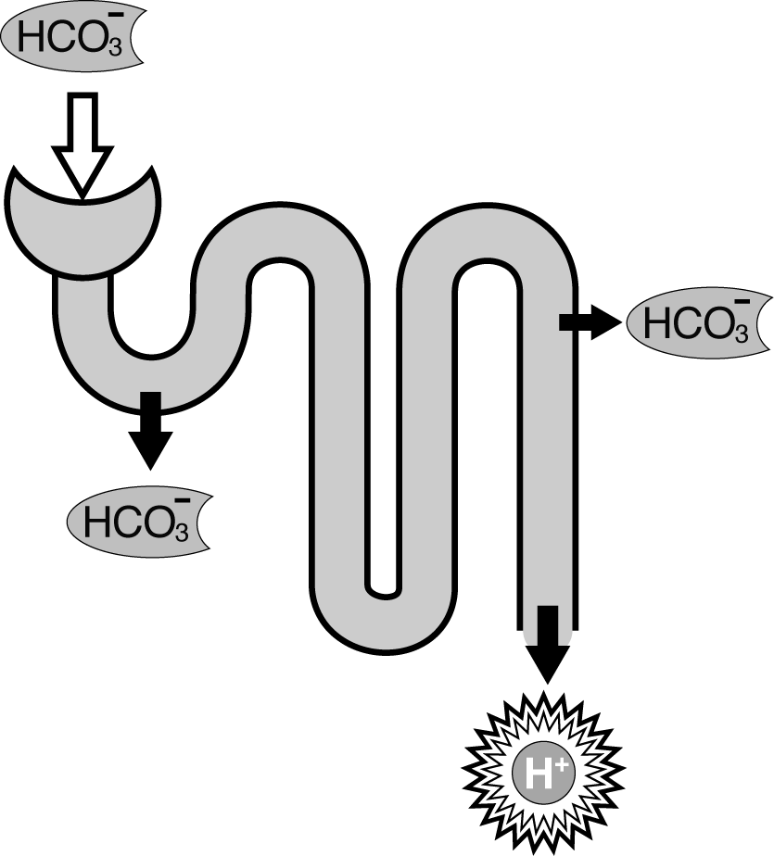
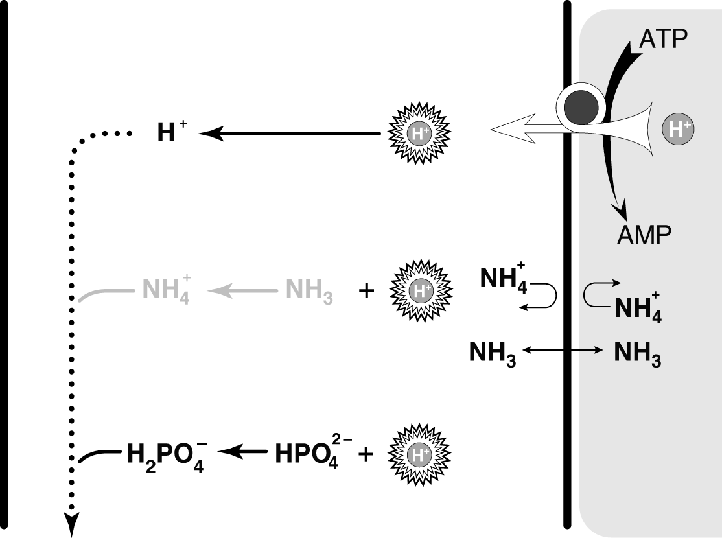
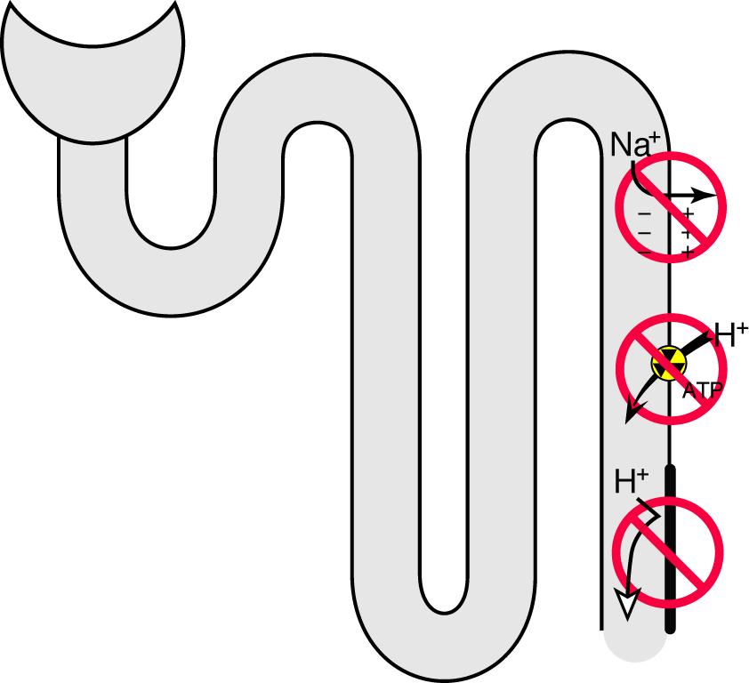
NAGMA and urinary anion gap
Diarrhea
Negative
Proximal RTA
At baseline
Negative (variable)
During treatment
Positive
During acid load
Negative
Distal RTA:
Positive
Type IV RTA
Positive
24 mmol/L
15 mmol/L
12 mmol/L
15 mmol/L
15 mmol/L
12 mmol/L
pH 8
pH 5
pH 5

Slide 70
32 y.o. female with fatigue, weakness and muscle aches
16
1.0
139 115
3.1 17
7.34 / 87 / 33 / 16

Slide 71
16
1.0
139 115
3.1 17
U/A pH 6.5
Urine electrolytes
80 115
45
7.34 / 87 / 33 / 16
Appropriately compensated non-anion gap metabolic acidosis due to distal RTA

Slide 72
74 y.o. female with 34 year history of DM c/o weakness
App.GoSoapbox.com 665-971-584
Answer polls:
Dowager Countess: What is the primary acid-base…
Dowager Countess: What is the appropriate pCO2…
Dowager Countess: What additional acid-base disorders are present
21
1.2
139 123
6.6 17
7.34 / 87 / 33 / 16
Albumin 1.8
Notes:
Dowager Countess of Grantham

Slide 73
74 y.o. female with 34 year history of DM c/o weakness
21
1.2
139 123
6.6 17
7.34 / 38 / 92 / 16
Albumin 1.8
Notes:
Dowager Countess of Grantham

Slide 74
Determine the primary disorder
7.28
7.28 / 38 / 92 / 16
pH / pCO2 / pO₂ / HCO₃
Acidosis or alkalosis
If the pH is less than 7.4 it is acidosis
If the pH is greater than 7.4 it is alkalosis
Acidosis or alkalosis
If the pH is less than 7.4 it is acidosis
If the pH is greater than 7.4 it is alkalosis
Metabolic Acidosis
Determine if it is respiratory or metabolic
If the pH, bicarbonate and pCO₂ all move in the same direction (up or down) it is metabolic
If the pH, bicarbonate and pCO₂ move in discordant directions (up and down) it is respiratory
Determine if it is respiratory or metabolic
If the pH, bicarbonate and pCO₂ all move in the same direction (up or down) it is metabolic
If the pH, bicarbonate and pCO₂ move in discordant directions (up and down) it is respiratory

Slide 75
Predicting pCO₂ in metabolic acidosis: Winter’s Formula
Expected pCO₂ = (1.5 x HCO₃) + 8 ±2
Expected pCO₂ = 31-35
Actual pCO₂ is 38, which is higher than predicted, so the patient has an additional respiratory acidosis
7.23 / 38 / 92 / 16
pH / pCO₂ / pO₂ / HCO₃
Combined metabolic acidosis and respiratory acidosis

Slide 76
Calculating the anion gap
16
1.0
139 123
6.6 17
A negative anion gap!
That’s got to mean something!
Anion gap = Na – (HCO₃ + Cl)
Anion gap = 139 – (123 + 17)
Anion gap = -1

Slide 77
Hypoalbuminuria, hypophosphatemia
The “other anions” includes phosphate and albumin
Hypoalbuminuria and hypophosphatemia lowers the anion gap
If one fails to adjust the upper and lower limit of the normal anion gap, altered albumin and phosphorous can hide a pathologic anion gap
Adjusted Normal Anion Gap
To estimate the normal anion gap for any individual multiply the albumin by 2.5 and add half the phosphorous

Slide 78
Other causes of a low anion gap
Increased chloride
Hypertriglyceridemia
Bromide
Iodide
Decreased “Unmeasured anions”
Albumin
Phosphorous
IgA
Increased “Unmeasured cations”
Hyperkalemia
Hypercalcemia
Hypermagnesemia
Lithium
Increased cationic paraproteins
IgG
Sodium
Chloride
Bicarb
Albumin
Phos
IgA
Normal Anion gap
Potassium
Calcium
Magnesium
IgG

Slide 79
Recent lab history
Albumin falls 2 g/dL
Potassium climbs 2 mmol/L
Anion Gap falls 7 from 6 to -1

Slide 80
Diagnose the cause of:
non-anion gap metabolic acidosis with hyperkalemia
Type four RTA, hyporenin-hypoaldo
Hyperkalemic Distal (Type 1) RTA, voltage dependent distal RTA
Notes:
Autonomic sympathetic NS required for conversion of pro-renin to renin so with dysregulation of autonomic NS with DM get high levels of pro-renin low renin and then secondary low aldo this leads to hyperK which surpresses ammonia production. Ammonia is needed to produce ammonium along with acid.

Slide 81
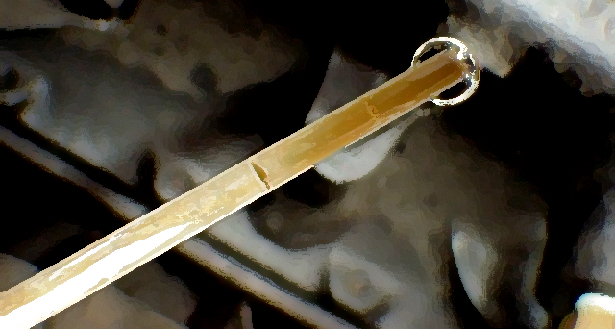
A dipstick for aldosterone activity:
The trans-tubular potassium gradient The TTKG

Slide 82
disclaimer
The TTKG is not useful in the diagnosis of hyperkalemia.
Persistent hyperkalemia is always associated with an inappropriately low TTKG.
The TTKG can be helpful in differentiating renal from extra-renal potassium losses in hypokalemia
Recent data on solute handling in the medullary collecting duct calls into question the physiologic assumptions required for the TTKG to be valid.
http://www.ncbi.nlm.nih.gov/m/pubmed/21788894/

Slide 83
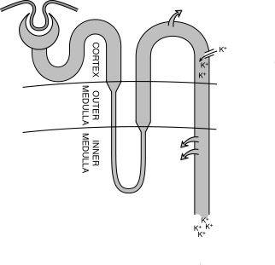
Trans-tubular Potassium Gradient (TTKG)
The ratio of tubular to venous K indicates the level of aldosterone activity.
In the presence of hyperkalemia the ratio should be > 10.
In the presence of hypokalemia the ratio of < 4.

Slide 84
Trans-tubular Potassium Gradient (TTKG)
The trans-tubular potassium gradient adjusts the urine potassium for water loss in the collecting ducts.
This allows the use of urinary potassium to calculate the ratio of potassium from the tubule to the interstitium in the CCD.

Slide 85
Trans-tubular Potassium Gradient (TTKG)
Fluid leaving the LoH has an osmolality of 100 mOsm/Kg
In the presence of ADH water leaves the DCT so that the tubular fluid becomes isosmotic
Pre-requisites to using the TTKG as a measure of aldosterone activity:
Urine osmolality > serum osmolality
Urine Na > 20 mmol/L

Slide 86
Trans-tubular Potassium Gradient (TTKG)
Lets play low, normal or high! TTKG and Aldo level
Type four RTA, hyporenin-hypoaldo
Type four RTA, hyporenin-hypoaldo
Low TTKG
Low aldosterone
Hyperkalemic Distal (Type 1) RTA, voltage dependent distal RTA
Hyperkalemic Distal (Type 1) RTA, voltage dependent distal RTA
Low TTKG
High aldosterone
Notes:
Autonomic sympathetic NS required for conversion of pro-renin to renin so with dysregulation of autonomic NS with DM get high levels of pro-renin low renin and then secondary low aldo this leads to hyperK which surpresses ammonia production. Ammonia is needed to produce ammonium along with acid.

Slide 87
74 y.o. female with 34 year history of DM c/o weakness
Both the bicarbonate and potassium were normal at admission. This is hospital acquired RTA (type 1 or 4)

Slide 88
Lets play: Name that drug!
Hospital acquired RTA really means drug induced RTA
Answer poll: name that drug
Type four RTA, hyporenin-hypoaldo
Type four RTA, hyporenin-hypoaldo
Spironolactone
ACEi/ARB
Heparin
Hyperkalemic Distal (Type 1), voltage dependent distal RTA
Hyperkalemic Distal (Type 1), voltage dependent distal RTA
Amiloride
Triamterene
Trimethoprim
Notes:
Autonomic sympathetic NS required for conversion of pro-renin to renin so with dysregulation of autonomic NS with DM get high levels of pro-renin low renin and then secondary low aldo this leads to hyperK which surpresses ammonia production. Ammonia is needed to produce ammonium along with acid.

Slide 89
Lets play: Name that drug!
Hospital acquired RTA really means drug induced RTA
Type four RTA, hyporenin-hypoaldo
Type four RTA, hyporenin-hypoaldo
Spironolactone
ACEi/ARB
Heparin
Hyperkalemic Distal (Type 1), voltage dependent distal RTA
Hyperkalemic Distal (Type 1), voltage dependent distal RTA
Amiloride
Triamterene
Trimethoprim
Notes:
Autonomic sympathetic NS required for conversion of pro-renin to renin so with dysregulation of autonomic NS with DM get high levels of pro-renin low renin and then secondary low aldo this leads to hyperK which surpresses ammonia production. Ammonia is needed to produce ammonium along with acid.

Slide 90
74 y.o. female with 34 year history of of DM and c/o weakness
Patient’s TTKG was 2.7 with a K of 5.7
Aldosterone was 22
The patient had been started on a high dose of TMP/SMX for a partially resistant urinary tract infection
Type four RTA, hyporenin-hypoaldo
Hyperkalemic Distal (Type 1), voltage dependent distal RTA
Notes:
Autonomic sympathetic NS required for conversion of pro-renin to renin so with dysregulation of autonomic NS with DM get high levels of pro-renin low renin and then secondary low aldo this leads to hyperK which surpresses ammonia production. Ammonia is needed to produce ammonium along with acid.

Slide 91
Two women with non-anion gap metabolic acidosis
One with hypokalemia
One with hyperkalemia
Both with distal RTA

Slide 92
Lets do some cases
App.GoSoapbox.com
665-971-584

Slide 93
Lets do some cases

Slide 94
25 year old man CC: Recurrent kidney stones
serum
urine
14
1.2
137 112
3.5 17
55 73
23
urine pH 6.5
Type 1 classical distal RTA
Answer poll: 25 year old recurrent kidney stones
Notes:
Anion gap?
Urine anion gap?
Is there much ammonia in the urine?
How would this differ from a patient with diarrhea?

Slide 95
36 yr old. Diabetes since age 12, retino-pathy, neuropathy. On insulin and ACEi
32
1.9
142 112
6.0 20
urine pH 6.5
Answer poll: 36 year old diabetic

Slide 96
25 year old man CC: Recurrent kidney stones
serum
urine
14
1.2
137 112
3.5 17
55 73
23
urine pH 6.5
Type 1 classical distal RTA
Notes:
Anion gap?
Urine anion gap?
Is there much ammonia in the urine?
How would this differ from a patient with diarrhea?

Slide 97
36 yr old. Diabetes since age 12, retino-pathy, neuropathy. On insulin and ACEi
32
1.9
142 112
6.0 20
urine pH 5.5
Type 4 RTA
What do you do?

Slide 98
36 yr old. Diabetes since age 12, retino-pathy, neuropathy. On insulin but not an ACEi
32
1.9
142 112
4.7 23
urine pH 5.5
Type 4 RTA

Slide 99
36 yr old. Diabetes since age 12, retino-pathy, neuropathy. On insulin and ACEi
32
1.9
54
2.6
142 112
6.0 20
132 98
6.2 10
600
36
2.0
urine pH 6.5
135 115
4.8 14
300
7.31 / 30 / 115 / 15
Answer poll: same 36 year old, 6 months later

Slide 100
36 yr old. Diabetes since age 12, retino-pathy, neuropathy. On insulin but not an ACEi
32
1.9
54
2.6
142 112
4.7 23
132 98
6.2 10
600
36
2.0
urine pH 5.5
135 115
4.8 14
300
7.31 / 30 / 115 / 15

Slide 101
Type 4 RTA
Top left is type 4 RTA
Bottom left is same patient with addition of diuretic
Top right is AGMA due to DKA
Bottom right is NAGMA in the recovery phase of DKA with dilutional acidosis

Slide 102
45 year old with alcohol abuse. Also c/o occasional diarrhea.
10
0.6
132 107
3.2 17
Albumin 2.9
7.44 / 28 / 96 / 19
Answer poll: 45 year old alcoholic

Slide 103
45 year old with alcohol abuse. Also c/o occasional diarrhea.
10
0.6
132 107
3.2 17
Albumin 2.9
7.44 / 28 / 96 / 19

Slide 104
22 y.o. AA female with hyperkalemia and microscopic hematuria
Urinalysis
1.015
pH 6.5
+ Blood
+ WBC
20-50 RBC
1 RBC cast
18
1.2
140 115
6.0 18
Systemic Lupus Erethematosus
Electrogenic Distal RTA
Answer poll: 22 y.o. with microscopic hematuria
Notes:
Case 5-Hyperkalemia and Non-Anion Gap Acidosis
Here is a lady in her 20s and her electrolytes are as follows: sodium 140, potassium 6.0, chloride 115, bicarbonate 18, and a creatinine of 1.5. As an aside, her urinalysis has protein, red cells, plus/minus red cell casts, not sure, and some pigmented granular casts of fair size. She is a 22-year-old lady. She is not on, at this point, any medication. She is not on an ACE; she is not on NSAID; and she is not on any diuretic. A 22-year-old lady with hyperkalemia and non-anion gap acidosis - what would you like to know? What is her urine pH? Her urine pH is either 6 or 5. We are not sure with the dipstick. Let us say that it is 6 for now.
Audience: What are her complaints?
Dr. Alexander: She has a malar rash. She has some joint pains, and she is losing her hair, which is really why she came in. This is a lady with lupus. No issue. Let us deal with what the acid-base problem is.
Audience: Scenario may be systemic lupus erythematosus with RTA type 2 with hyperkalemia.
Dr. Alexander: She has lupus and type 2 proximal RTA, but also has a distal defect that prevents potassium secretion.
Creatinine is 1.5. What is the purpose of this case and what do I want to drive home to you? To find hyperkalemia in this patient and a urine pH without infection in her urine of 6. Does that fit? It just does not quite do it for me. I would be concerned that one of those numbers might not be right. Can you put that into any syndrome? It is possible that she could have had the syndrome as the young lady said. But urine pH of 6, hyperkalemia, and lupus does not quite fit. So, my first go with this is, "Gee! Maybe we better check this again." Is that fair to do that to you guys? The answer is of course not, but this is real life and this is what happens. The house staff calls, primary care doctor calls and says, "this is what I got." And so what do you have to think about it? For me, I would say, "First thing is, if I am concerned - and I am obviously - about renal tubular acidosis, let us be sure that she really cannot acidify her urine. Let us see what is going on." It turns out when we do check her with an electrode, it is right. She has a pH above 5.5. How does that fit now? I talked this morning about a small percentage of patients who have lupus, who are hyperkalemic, and have type 1 hyperkalemic distal RTA. She would fit into that category of patient. Same kind of patient often in a sickle cell, not SA, but SS, occasionally with obstruction. These are the patients, I think you will see because I have seen many of them. And you need to be tuned into that kind of problem. Here, of course, part of the problem may well be the hyperkalemia preventing her from acidifying her urine by impairing her ammoniagenesis. If we can get her potassium down, in this kind of patient, probably we will end up using a diuretic. This is probably the most effective thing we can do, and she will improve in terms of her acidemia. Not a rare case, not a common case, but something we need to be tuned into.
Audience: What does the biopsy show in a patient like this with lupus?
Dr. Alexander: To the best of my knowledge, in patients like this, first of all, the defect is in the collecting duct. And hopefully with a biopsy, we are not seeing very much collecting duct. We are cortical. You may see a little cortical collecting duct, but not a lot. The only tubular impairment that I know of that has been demonstrated in lupus - I take that back, I was thinking of another disease. I do not know of any anatomic abnormalities, which have been defined which lead to this. I do not know. There may well be because we are just not seeing it. The likelihood is that she has some interstitial disease. You know most patients who have lupus with some renal impairment are going to have interstitial involvement and that is how we determine or guess at least what is going to happen to them eventually. So that would be my guess, but I do not know any data. I do not know of any publications looking at these patients with biopsy data.
Audience: Is there a level of creatinine above which you do not diagnosis a RTA?
Dr. Alexander: Take away type 4 distal RTA, because those mostly are with renal impairment, but the answer is at what level? How do you guess? The easiest answer? You have to have normal renal function, but maybe a little bit abnormal is okay. What is the problem? Why are we concerned? We are concerned because as soon as you develop renal impairment, you are developing renal tubular acidosis. You are not making enough ammonia. You are wasting bicarbonate. So is that a primary disease? The answer is no, it is secondary to whatever the original renal disease is. Then how do you say whether somebody has in fact a primary renal tubular acidosis at that point because they have a secondary renal tubular acidosis? The answer is that if you have data on the patient and you know that at x time with renal impairment maybe they did not have it and they may develop it, maybe, with the same GFR. You are walking on a very fine line. In real life, does it matter, as you take care of the patient? Not really, unless you are looking for some other primary disease which has led to RTA. For me at least, that is the only point where it really becomes important.
I suppose if you saw a lot of heavy calcification in the medulla, which would be typical of distal renal tubular acidosis, you could make that assumption. But I hope you would not see that on the biopsy.
Audience: In reference to the case of the diabetic, who got lots of fluids and had persistent low bicarbonate. Can you say a little about dilutional acidosis in patients who get lots of fluids and how you feel about that?
Dr. Alexander: It exists rarely. The report in the literature is from Adrogue. Those are cases where patients are in the MICU and SICU, and got huge amounts of volume, and so you have diluted down the bicarbonate. Can I spend a moment on so-called contraction alkalosis, which is one of my favorite things, which does not exist. I will flip it over to dilution. People talk about contraction alkalosis. If you took a beaker of water with a liter in it and you put in 25 mEq of bicarbonate, you would have 25 mEq per liter of bicarbonate. Now you stick that beaker out in the sun and you let it stand there and the water evaporates. If 10% of the water evaporates, what is the bicarbonate concentration? 10% of the water goes. Your bicarbonate goes up from 25 to 27.5. How many patients do you see that have more than 10% volume loss contraction? Not very many. That is a pretty big volume loss. How come in "contraction alkalosis" the bicarbonate is 35? It cannot be from contraction. That is not the physiology of it. The physiology of it is you are volume depleted, you turn on aldosterone, and aldosterone stimulates acid excretion in the urine, and you pee out the acid. And so you have alkalemia. It is alkalemia secondary to aldosteronism. The contraction part, that whole concept is really just physiologically bad thinking. What is going on is hyperaldosteronism and wasting of acid in the urine, which is what makes you alkalemic. With regard to dilutional acidosis, if you take that same beaker of water with 25 mEq of bicarbonate in it, and let us say there is enough buffer, so the pH is 7.4. You pour in lots of water, you are going to dilute down the bicarbonate. And if there is no way for adjustment to occur, you are going to lower the bicarbonate, and you are going to lower the pH. That is what they reported. In patients who were massively volume expanded, you see dilutional acidosis.

Slide 105
22 y.o. AA female with hyperkalemia and microscopic hematuria
Urinalysis
1.015
pH 6.5
+ Blood
+ WBC
20-50 RBC
1 RBC cast
18
1.2
140 115
6.0 18
Systemic Lupus Erethematosus
Electrogenic Distal RTA
Notes:
Case 5-Hyperkalemia and Non-Anion Gap Acidosis
Here is a lady in her 20s and her electrolytes are as follows: sodium 140, potassium 6.0, chloride 115, bicarbonate 18, and a creatinine of 1.5. As an aside, her urinalysis has protein, red cells, plus/minus red cell casts, not sure, and some pigmented granular casts of fair size. She is a 22-year-old lady. She is not on, at this point, any medication. She is not on an ACE; she is not on NSAID; and she is not on any diuretic. A 22-year-old lady with hyperkalemia and non-anion gap acidosis - what would you like to know? What is her urine pH? Her urine pH is either 6 or 5. We are not sure with the dipstick. Let us say that it is 6 for now.
Audience: What are her complaints?
Dr. Alexander: She has a malar rash. She has some joint pains, and she is losing her hair, which is really why she came in. This is a lady with lupus. No issue. Let us deal with what the acid-base problem is.
Audience: Scenario may be systemic lupus erythematosus with RTA type 2 with hyperkalemia.
Dr. Alexander: She has lupus and type 2 proximal RTA, but also has a distal defect that prevents potassium secretion.
Creatinine is 1.5. What is the purpose of this case and what do I want to drive home to you? To find hyperkalemia in this patient and a urine pH without infection in her urine of 6. Does that fit? It just does not quite do it for me. I would be concerned that one of those numbers might not be right. Can you put that into any syndrome? It is possible that she could have had the syndrome as the young lady said. But urine pH of 6, hyperkalemia, and lupus does not quite fit. So, my first go with this is, "Gee! Maybe we better check this again." Is that fair to do that to you guys? The answer is of course not, but this is real life and this is what happens. The house staff calls, primary care doctor calls and says, "this is what I got." And so what do you have to think about it? For me, I would say, "First thing is, if I am concerned - and I am obviously - about renal tubular acidosis, let us be sure that she really cannot acidify her urine. Let us see what is going on." It turns out when we do check her with an electrode, it is right. She has a pH above 5.5. How does that fit now? I talked this morning about a small percentage of patients who have lupus, who are hyperkalemic, and have type 1 hyperkalemic distal RTA. She would fit into that category of patient. Same kind of patient often in a sickle cell, not SA, but SS, occasionally with obstruction. These are the patients, I think you will see because I have seen many of them. And you need to be tuned into that kind of problem. Here, of course, part of the problem may well be the hyperkalemia preventing her from acidifying her urine by impairing her ammoniagenesis. If we can get her potassium down, in this kind of patient, probably we will end up using a diuretic. This is probably the most effective thing we can do, and she will improve in terms of her acidemia. Not a rare case, not a common case, but something we need to be tuned into.
Audience: What does the biopsy show in a patient like this with lupus?
Dr. Alexander: To the best of my knowledge, in patients like this, first of all, the defect is in the collecting duct. And hopefully with a biopsy, we are not seeing very much collecting duct. We are cortical. You may see a little cortical collecting duct, but not a lot. The only tubular impairment that I know of that has been demonstrated in lupus - I take that back, I was thinking of another disease. I do not know of any anatomic abnormalities, which have been defined which lead to this. I do not know. There may well be because we are just not seeing it. The likelihood is that she has some interstitial disease. You know most patients who have lupus with some renal impairment are going to have interstitial involvement and that is how we determine or guess at least what is going to happen to them eventually. So that would be my guess, but I do not know any data. I do not know of any publications looking at these patients with biopsy data.
Audience: Is there a level of creatinine above which you do not diagnosis a RTA?
Dr. Alexander: Take away type 4 distal RTA, because those mostly are with renal impairment, but the answer is at what level? How do you guess? The easiest answer? You have to have normal renal function, but maybe a little bit abnormal is okay. What is the problem? Why are we concerned? We are concerned because as soon as you develop renal impairment, you are developing renal tubular acidosis. You are not making enough ammonia. You are wasting bicarbonate. So is that a primary disease? The answer is no, it is secondary to whatever the original renal disease is. Then how do you say whether somebody has in fact a primary renal tubular acidosis at that point because they have a secondary renal tubular acidosis? The answer is that if you have data on the patient and you know that at x time with renal impairment maybe they did not have it and they may develop it, maybe, with the same GFR. You are walking on a very fine line. In real life, does it matter, as you take care of the patient? Not really, unless you are looking for some other primary disease which has led to RTA. For me at least, that is the only point where it really becomes important.
I suppose if you saw a lot of heavy calcification in the medulla, which would be typical of distal renal tubular acidosis, you could make that assumption. But I hope you would not see that on the biopsy.
Audience: In reference to the case of the diabetic, who got lots of fluids and had persistent low bicarbonate. Can you say a little about dilutional acidosis in patients who get lots of fluids and how you feel about that?
Dr. Alexander: It exists rarely. The report in the literature is from Adrogue. Those are cases where patients are in the MICU and SICU, and got huge amounts of volume, and so you have diluted down the bicarbonate. Can I spend a moment on so-called contraction alkalosis, which is one of my favorite things, which does not exist. I will flip it over to dilution. People talk about contraction alkalosis. If you took a beaker of water with a liter in it and you put in 25 mEq of bicarbonate, you would have 25 mEq per liter of bicarbonate. Now you stick that beaker out in the sun and you let it stand there and the water evaporates. If 10% of the water evaporates, what is the bicarbonate concentration? 10% of the water goes. Your bicarbonate goes up from 25 to 27.5. How many patients do you see that have more than 10% volume loss contraction? Not very many. That is a pretty big volume loss. How come in "contraction alkalosis" the bicarbonate is 35? It cannot be from contraction. That is not the physiology of it. The physiology of it is you are volume depleted, you turn on aldosterone, and aldosterone stimulates acid excretion in the urine, and you pee out the acid. And so you have alkalemia. It is alkalemia secondary to aldosteronism. The contraction part, that whole concept is really just physiologically bad thinking. What is going on is hyperaldosteronism and wasting of acid in the urine, which is what makes you alkalemic. With regard to dilutional acidosis, if you take that same beaker of water with 25 mEq of bicarbonate in it, and let us say there is enough buffer, so the pH is 7.4. You pour in lots of water, you are going to dilute down the bicarbonate. And if there is no way for adjustment to occur, you are going to lower the bicarbonate, and you are going to lower the pH. That is what they reported. In patients who were massively volume expanded, you see dilutional acidosis.

Slide 106
Most common error in acid-base
Personal observation

Slide 107
AE
66 yo white male
PMHx DM, paraplegia 2° MVA
Klebsiella urosepsis induced ARF
Blood Cxrs + for Klebsiella

Slide 108
8/16
31
1.2
8/29
56
2.8
139 107
5.4 20
139 111
3.9 14
Start bicarbonate gtt
8/26
38
1.9
8/30
62
3.0
138 104
4.4 21
137 104
3.5 22
8/28
53
2.9
137 108
3.8 16
7.52 / 58 / 31 / 25
Respiratory
alkalosis
Start oral bicarbonate

Slide 109
Done. Thank-you Please do the post test and answer the discussion question

